Slide 1

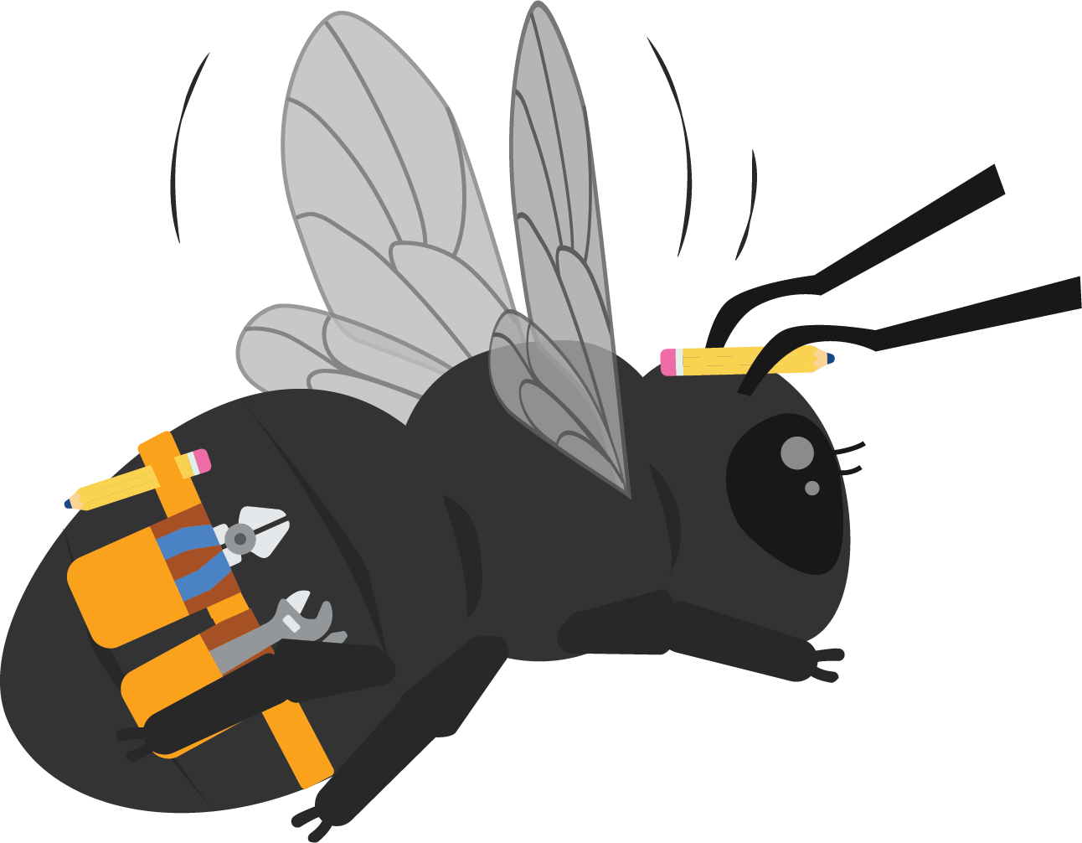
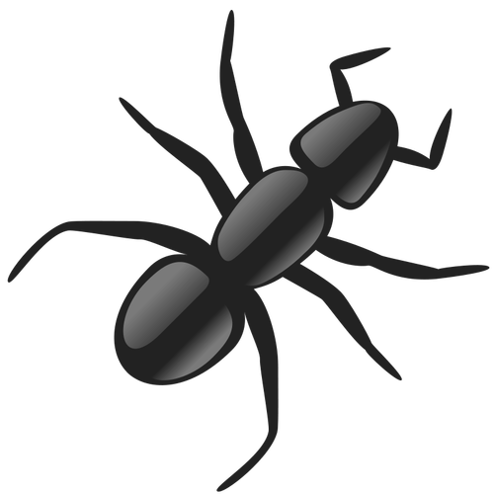

Ant Antics
Unit 3
Notes:
The driving question you pose to students in order to get them to investigate a problem.

Slide 2
Driving Question
How do ants react to light, sounds, and vibrations?
Notes:
The driving question you pose to students in order to get them to investigate a problem.

Slide 3
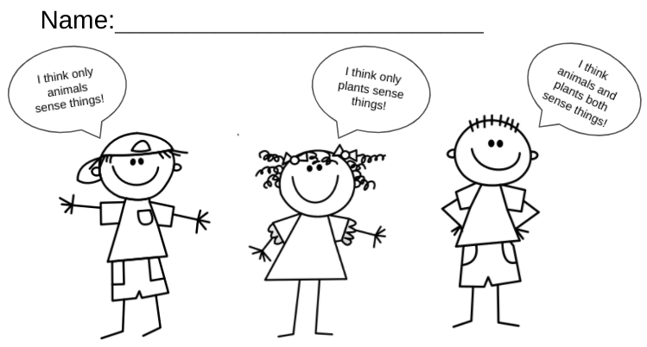
Probe
Notes:
Have students decide which child they agree with and color that child. Students will discuss their thinking. (think-pair-share)

Slide 4
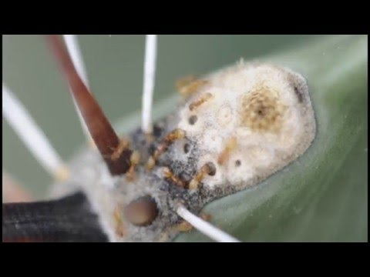
Phenomena
Let’s watch the video and revisit our wonder wall.
Did we answer any of our wonders?
Do we have any new wonders?
Notes:
Show ant video from the slide deck and ask students what they notice and what they wonder. Revisit the Wonderwall. Ask the students whether there are any wonders we have answered. Do you have any new wonders?. (wonderwall)

Slide 5
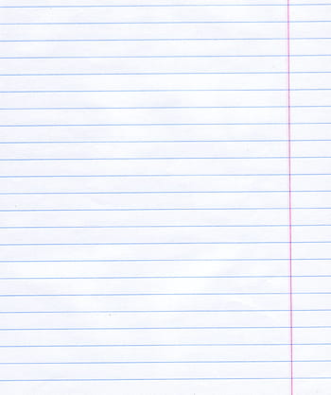
Engage
What are our five senses?
How do we use them?
Notes:
Make a list. (solo, pair, team)

Slide 6
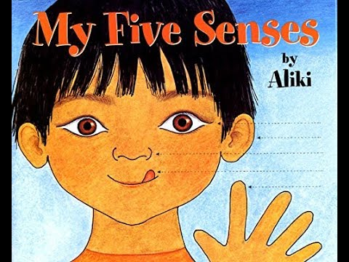
Engage
My Five Senses by Aliki
Notes:
What are our five senses? How do we use them? Write the student responses on the board. Read the story: My Five Senses by Aliki. Revisit the student's answers. Explain to students that today they will move through different centers, exploring their senses and recording their findings.

Slide 7
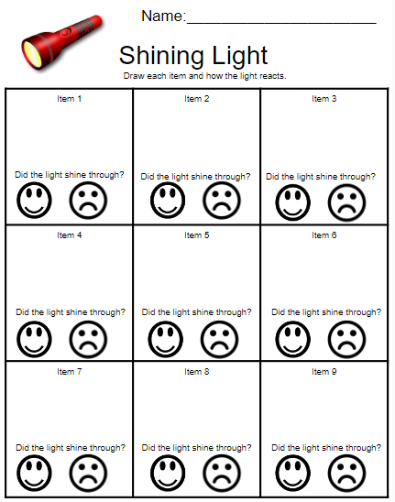
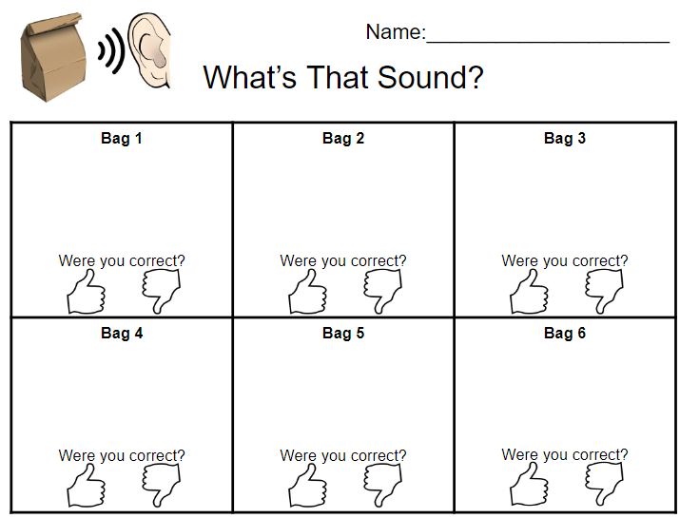
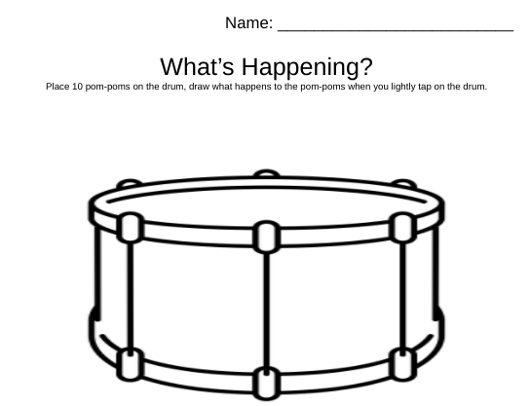
Engage
Today you will move through different centers, exploring your senses and recording your findings.
Notes:
Students will rotate to 3 different centers:. light, sound, and vibration (touch)

Slide 8
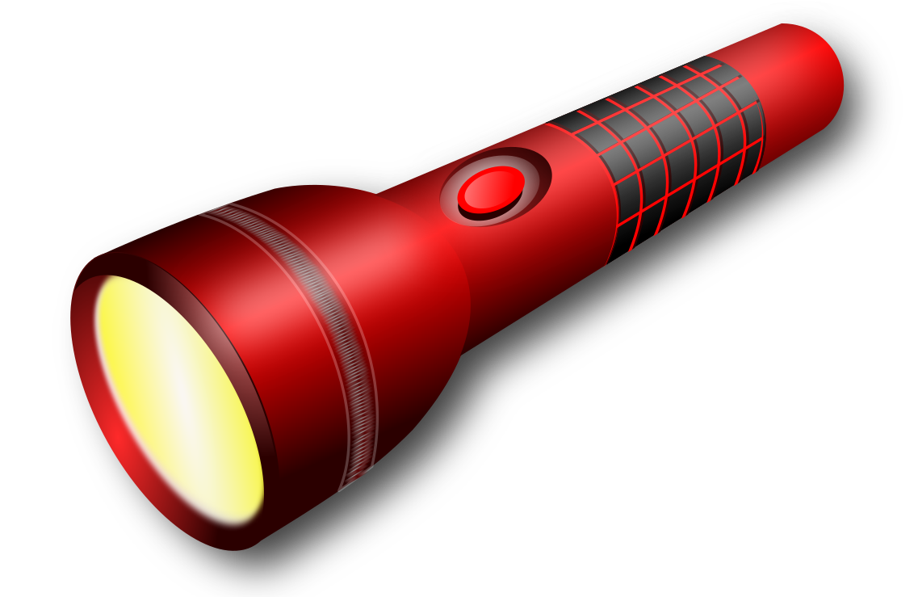
Center 1
Use a flashlight on various objects to see if the light will pass through them. You will document your observations.
Notes:
Students will use a flashlight on various objects to see if the light will pass through them. Students will document their observations on their Light Center handout.

Slide 9
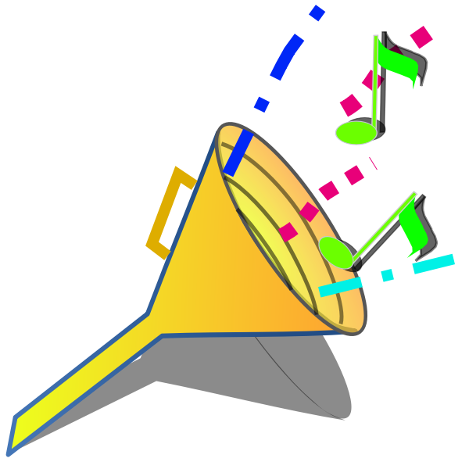
Center 2
No Peeking! Choose a bag. Shake the bag. Record your predictions. After you have recorded all your observations, check you answers by looking in the bags.
Notes:
The teacher will put the following items in their brown paper bags, (label bags 1,2,3, etc.) folding the bags closed (do not staple): bells, buttons, pom-poms, rattle, etc. Students will take turns shaking the bags and record what they believe is in their bags. After recording their answers, students can confirm their findings by looking in the bags.

Slide 10
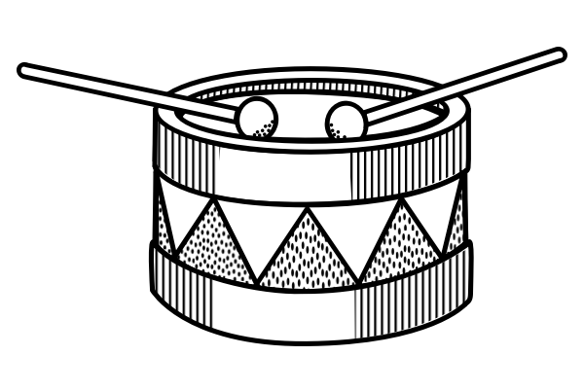
Center 3
Place 10 pom-poms on a drum. Lightly tap on the drum. What happens to the pom-poms? Record your findings.
Notes:
You need a small drum. Place ten pom-poms on the drum. The student will observe the pom-poms bouncing up and down on the drum as they lightly tap on the drum. Students will record their observations.

Slide 11
Explain
Why do you think the pom-poms were bouncing?
What object was the loudest? Why?
Why do you think light passed through some objects and not others?
Notes:
(think-pair-share)

Slide 12
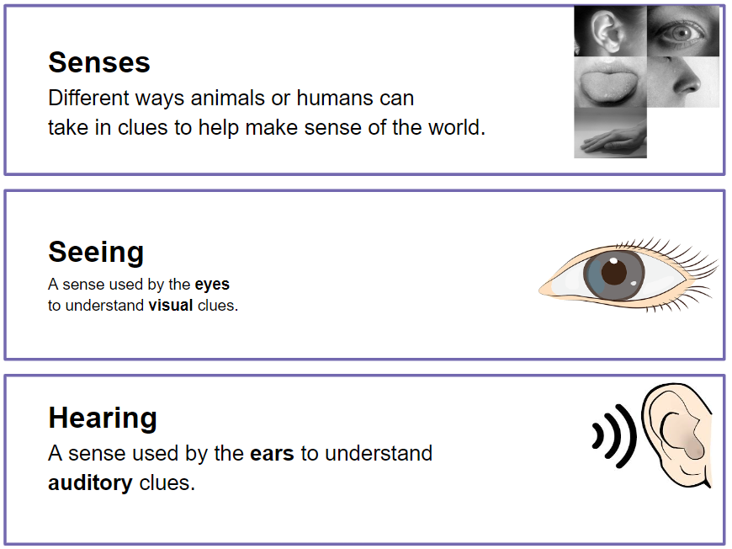

Notes:
Say the word. Have the students repeat the word
Explain the definition
Give an example

Slide 13
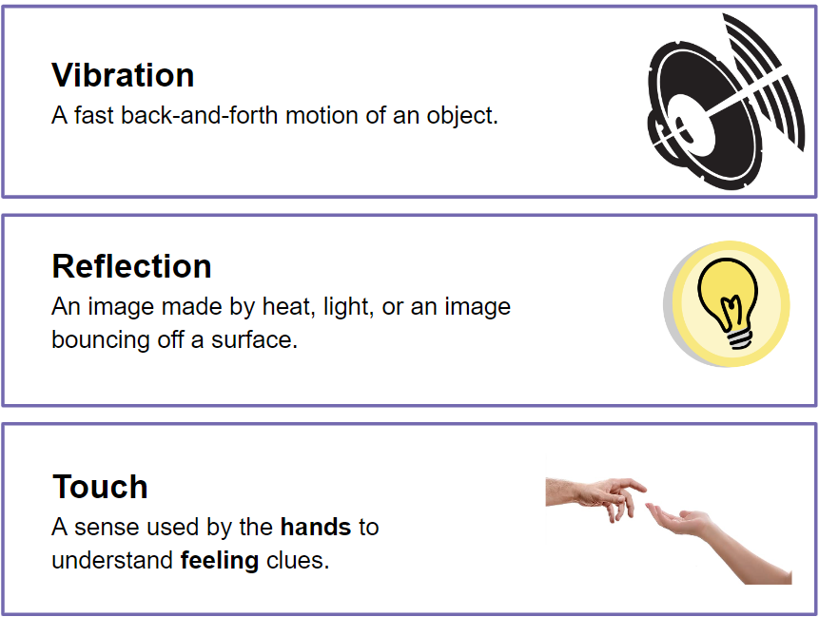
Notes:
Say the word. Have the students repeat the word
Explain the definition
Give an example

Slide 14
Elaborate
Hello Ants! We are going to watch ants and how they use their sense and how they respond to sound, light and vibration. We will record our observations in our Ant Farm journals.
Notes:
Ant Journal: Introduce the classroom ant farm. (You can also take a nature walk around your school to locate an ant hill/colony to use for the following observations.)
Ant Farm: How do the ants respond when exposed to light, sounds, and different foods (smell)?

Slide 15
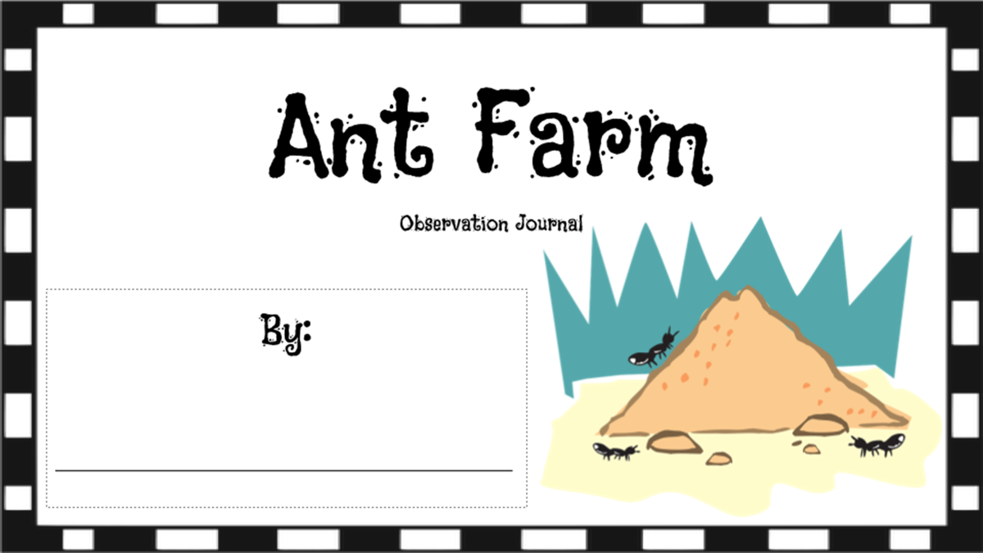
Notes:
Students will work in small groups to observe how ants react to light, sound, vibration, and different foods. Students use a flashlight to watch how the ants respond to light. Students use a musical instrument to observe how the ants respond to sound. Students use a tapping motion to observe how the ants respond to vibration. Ongoing, try feeding your ants different foods over several days. Observe and document findings.

Slide 16
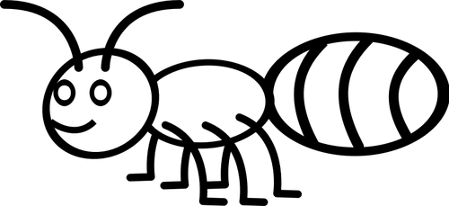
Head
Thorax
Abdomen
2 Antennae
6 legs

Slide 17
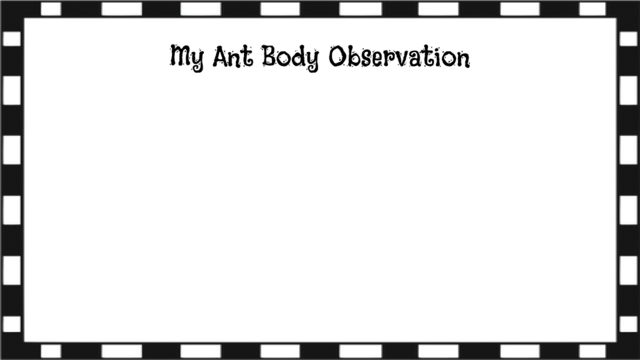

Slide 18
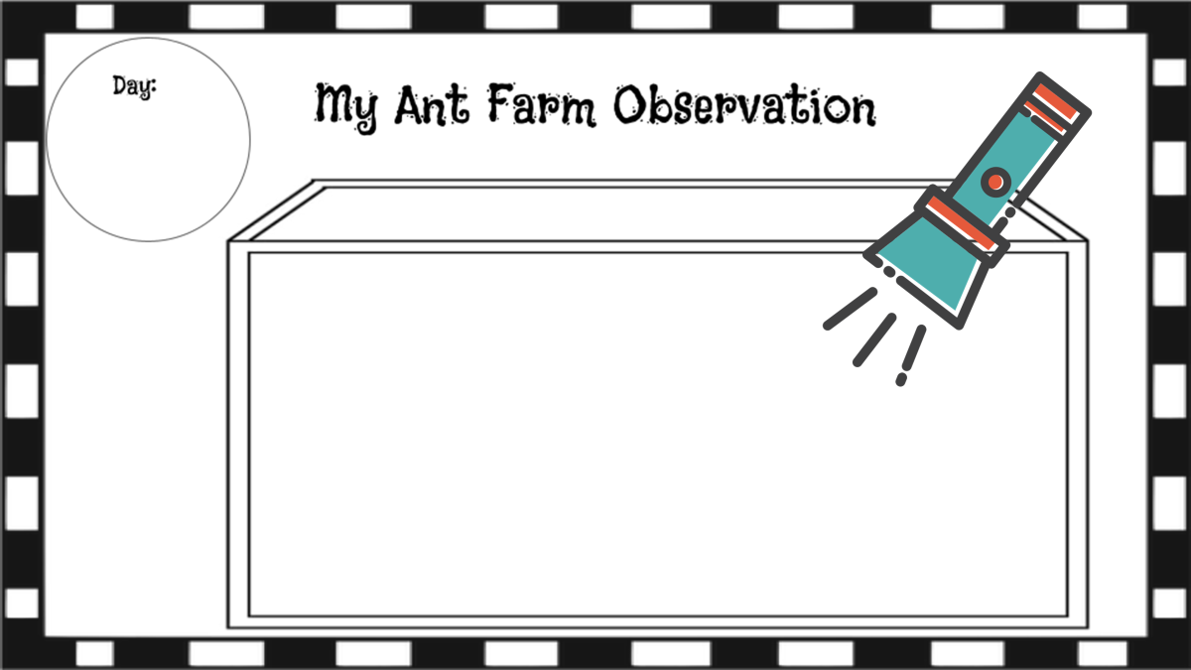

Slide 19
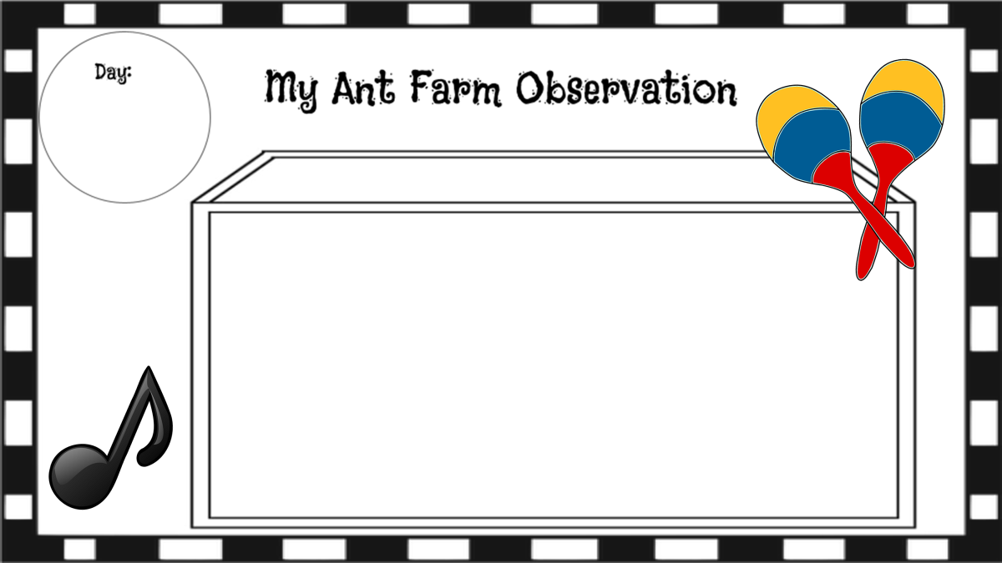

Slide 20
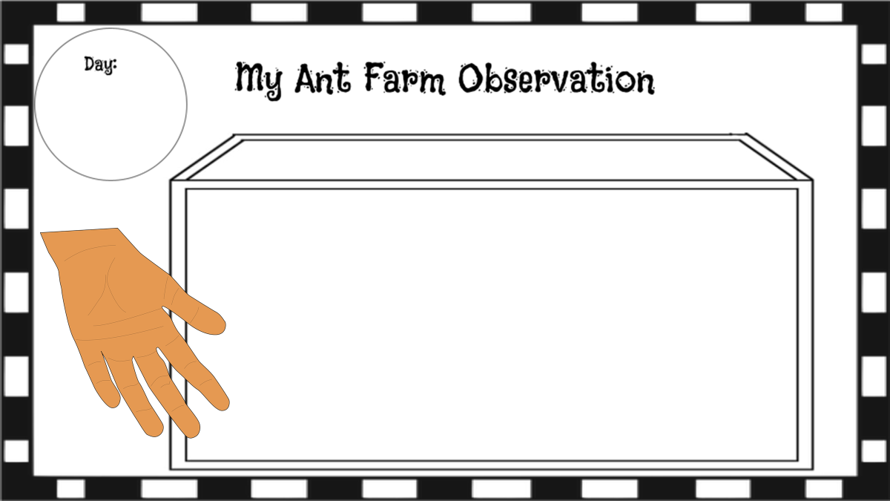

Slide 21
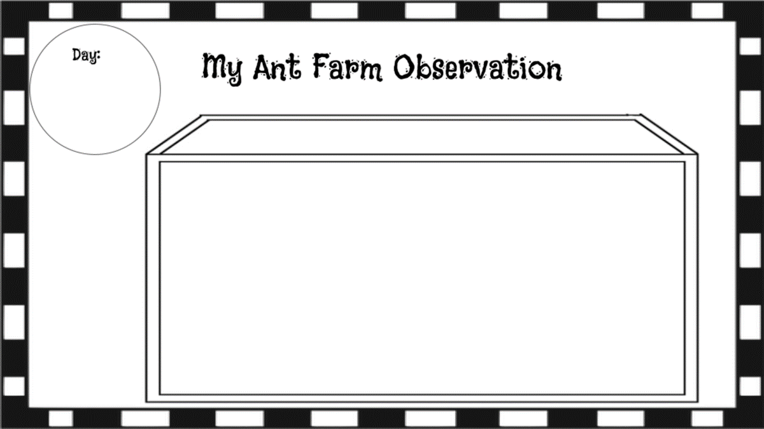
Notes:
Optional ideas: food observations, using different color lights, and different smells.

Slide 22
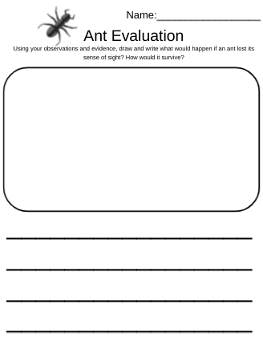
Evaluate
Using your observations and evidence, draw and write what would happen if an ant lost its sense of sight? How would it survive?

